Slide 1
Welcome to :
AI-Powered
NPC
Improvement!

Slide 2

What are
NPC
s ?

Slide 3

NPC
Non
stands for
Playable
Character
In the context of video games and virtual environments, an NPC refers to a character controlled by the game's artificial intelligence rather than by a player.

Slide 4
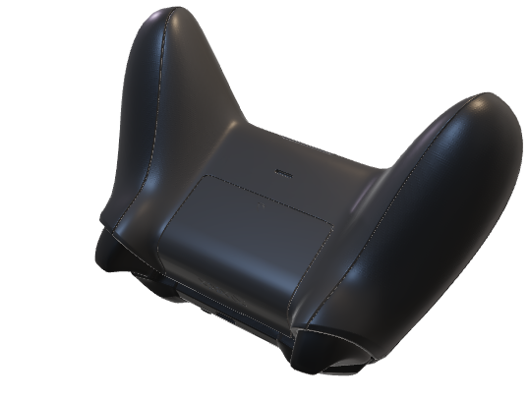
NPC
Evolution re-AI Era

Slide 5


Evolution re-AI Era
NPC

Slide 6

AI Era
In the early days,
NPC
s (non-player characters) in
video games were static and predictable, following fixed routines.

Slide 7
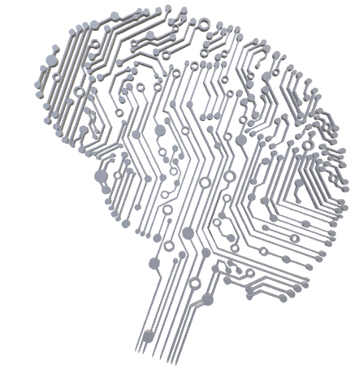
AI Era

Slide 8
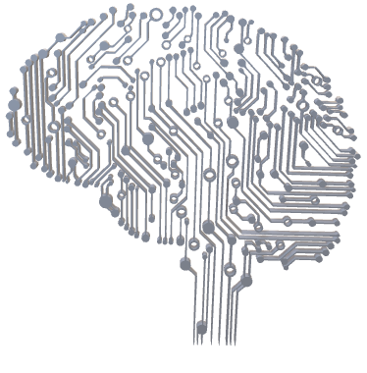
NPC
Join us as we uncover
the magic behind AI's role in
Enhancing your gaming
experience!
AI Era

Slide 9
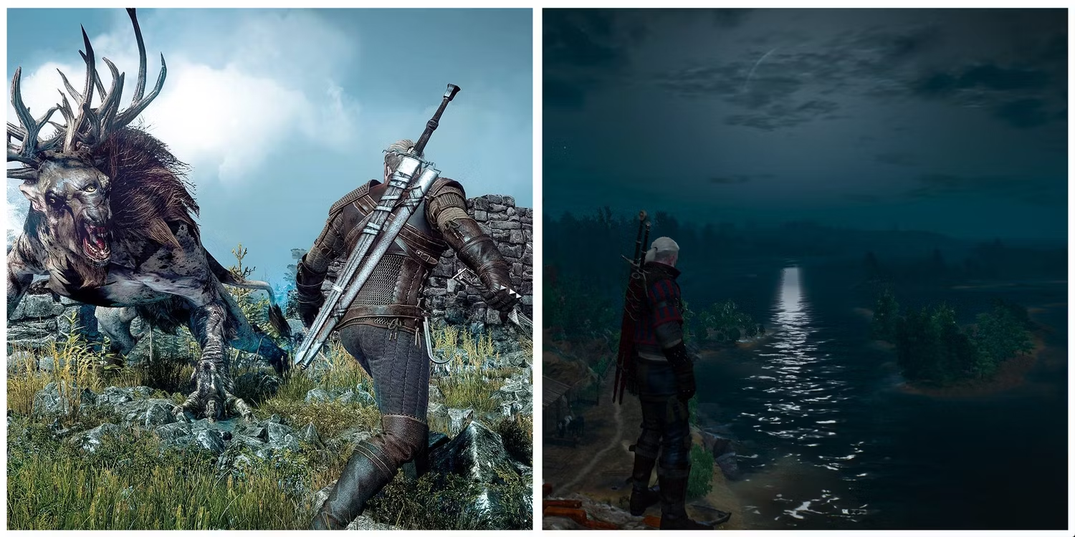
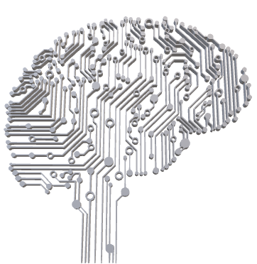
The evolution of NPC behavior has been remarkable, transitioning from rigid patterns to dynamic and responsive characters.
NPC
Day Night Cycle

Slide 10
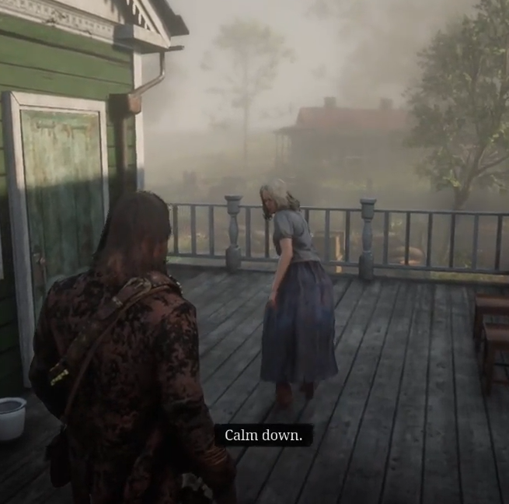
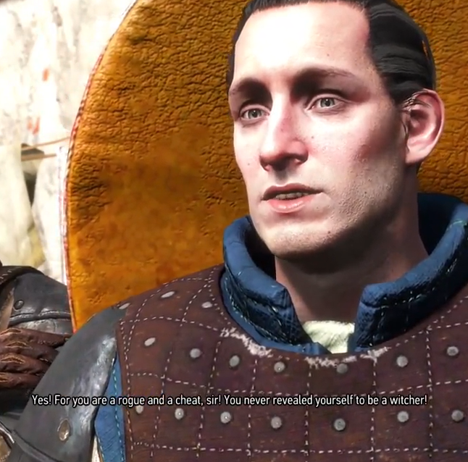
NPC’s reaction to players

Slide 11
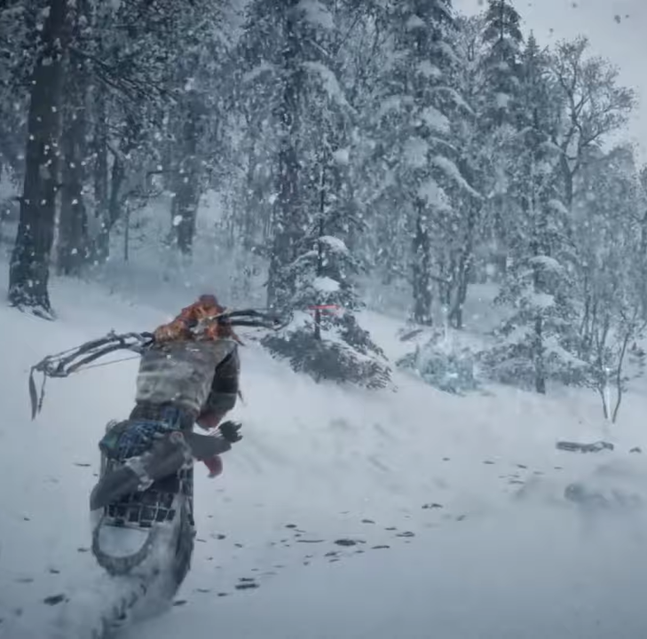
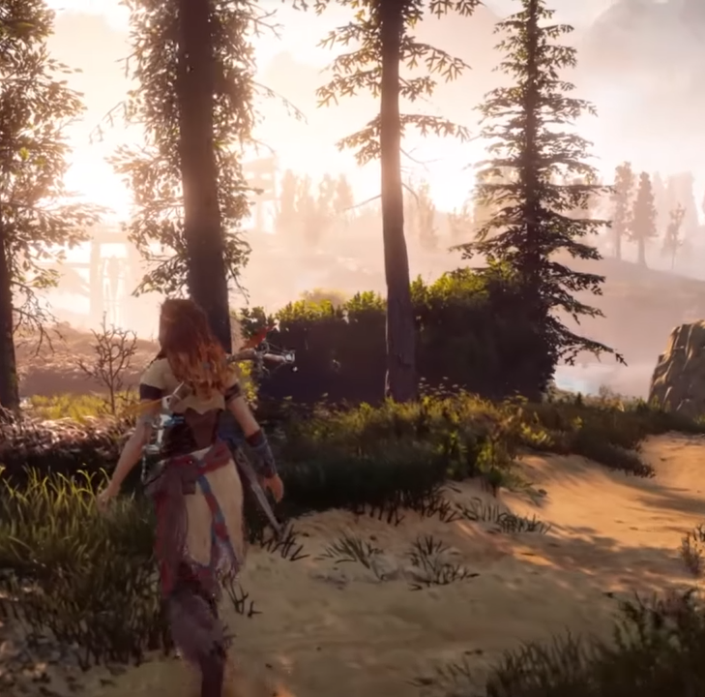
NPC’s reaction to weather

Slide 12
Today, NPCs have become more than just scripted entities, they are now adaptable and engaging elements within the gaming experience.
This transformation not only enhances the overall appeal of games but also introduces new challenges.
NPC’s reaction to weather

Slide 13
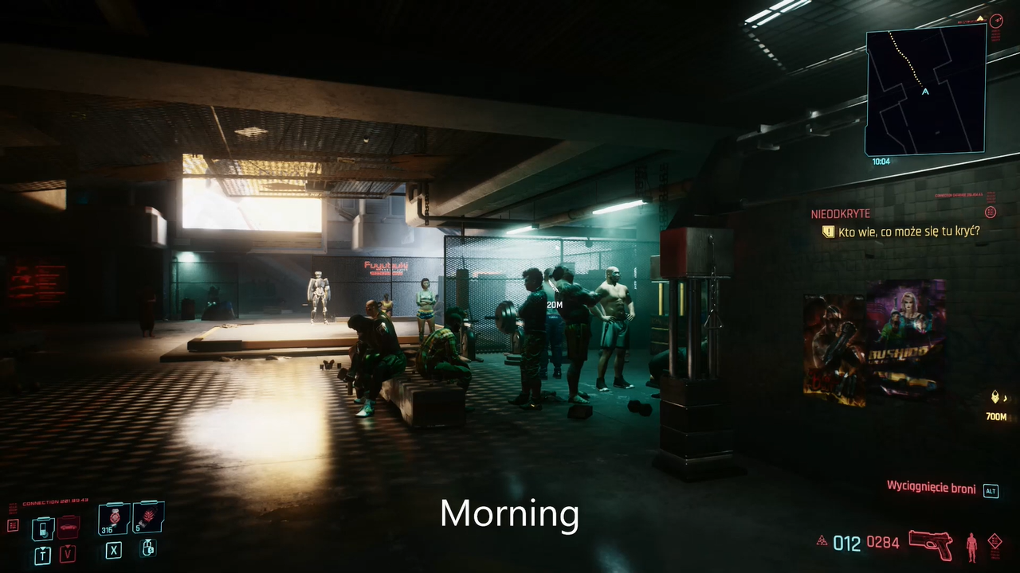
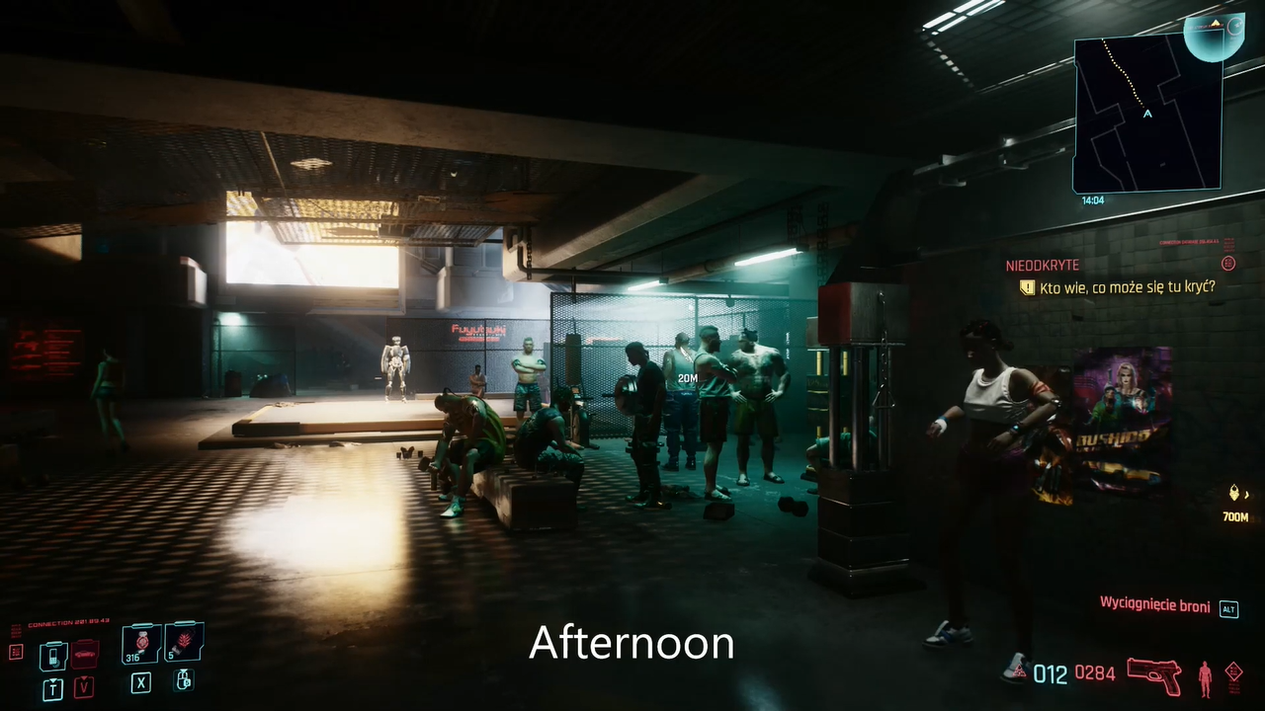
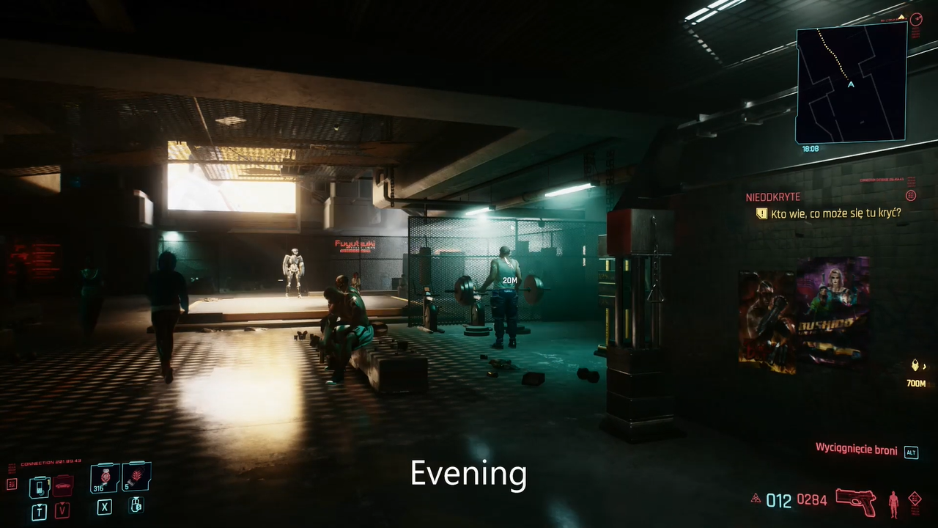
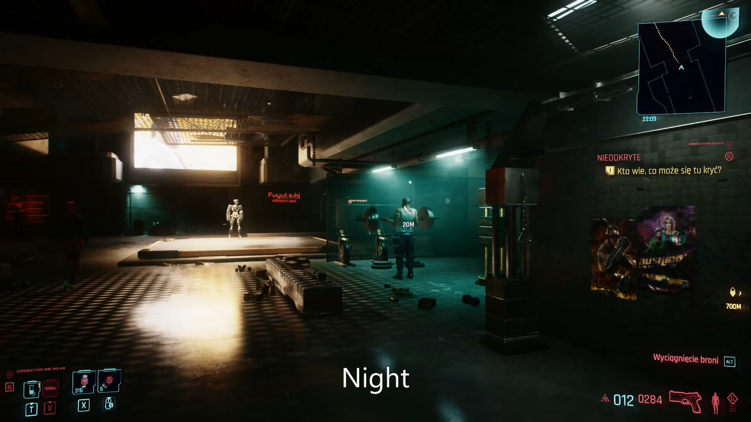
NPC’s reaction to weather
s having there own daily

Slide 14

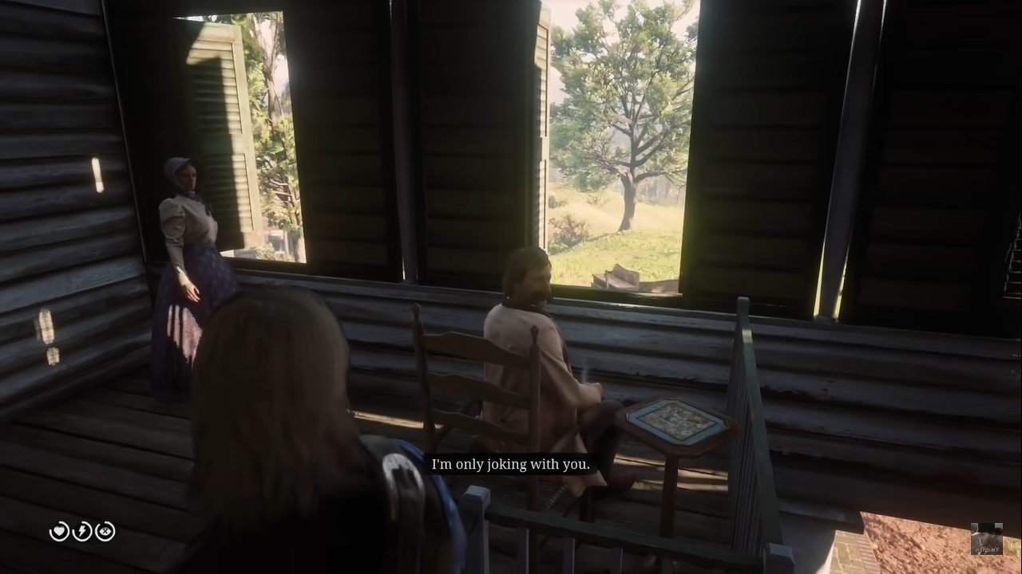
having a deeper interaction with players
NPC’s reaction to weather

Slide 15
The shift towards dynamic NPC behavior brings forth a unique opportunity for artificial intelligence (AI) to play a crucial role.
AI is now at the forefront, addressing the challenges posed by the evolving nature of NPCs, making gaming experiences more immersive and captivating.
NPC’s reaction to weather

Slide 16
The shift towards dynamic NPC behavior brings forth a unique opportunity for artificial intelligence (AI) to play a crucial role.
AI is now at the forefront, addressing the challenges posed by the evolving nature of NPCs, making gaming experiences more immersive and captivating.
NPC’s reaction to weather

Slide 17

NPC’s reaction to weather
AI Components

Slide 18

Decision-Making Algorithms:
Determine NPC reactions.
Act as the "brains" of NPCs.
NPC’s reaction to weather

Slide 19

Behavioral Models:
Set rules for NPC actions.
Guide behavior in various situations.
NPC’s reaction to weather

Slide 20
Emotional Intelligence Integration
Add realistic emotions to NPCs.
Enhance engagement and lifelike interactions.
NPC’s reaction to weather

Slide 21
The Role of Machine Learning in NPC Development
NPC’s reaction to weather
NPC’s reaction to weather
NPC’s reaction to weather

Slide 22
Learning from Players
NPCs observe and remember player actions..
Creating Dynamic Experiences
NPCs evolve with machine learning, offering different responses for a dynamic game world
NPC’s reaction to weather
NPC’s reaction to weather
NPC’s reaction to weather

Slide 23
Personalized Interactions
NPCs understand player preferences.
Examples in Action
Traditional: Fixed NPC behaviors.
Machine Learning: NPCs adapt patrol routes based on player actions
NPC’s reaction to weather
NPC’s reaction to weather
NPC’s reaction to weather

Slide 24
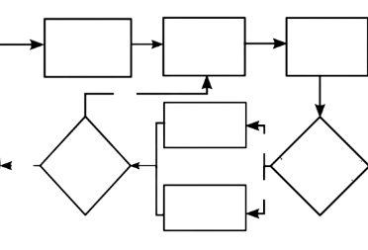
Start
Player Counting
10 - 0
Player try to find NPC
NPC found
Yes
NPC Caught
Yes
Is player arrives first in base
Stop
No
Is there still an NPC ?
No
NPC Safe

Slide 25
Dynamic Environments and NPC Interaction

Slide 26
Dynamic Elements( Procedural Content Generation (PCG)):
A technique where game content is algorithmically generated, creating dynamic, ever-changing landscapes and scenarios.

Slide 27
Responsive Environments( Adaptive NPCs):
Non-player characters that react dynamically to player actions, creating a realistic and unpredictable gaming environment

Slide 28
Player Engagement Elevated( Immersive Gameplay):
Players experience heightened engagement as they navigate through environments that evolve organically, keeping them on their toes.

Slide 29
Unpredictable Scenarios(No Two Playthroughs Alike):
Dynamic environments ensure that each gaming session is unique, preventing predictability and promoting exploration.

Slide 30
Lifelike Interactions(NPC Realism):
Responsive NPCs mimic human-like behavior, enhancing the overall gaming experience by creating more authentic and believable interactions.

Slide 31
Key Benefits:
The synergy of dynamic environments and NPC interaction transforms gaming into a captivating, lifelike adventure.

Slide 32
Challenges in NPC Improvement Using AI

Slide 33
Challenges
Challenges in NPC Improvement Using AI

Slide 34
Challenges
Realism vs. Resources:
Balancing realistic NPC behavior within limited resources.
Ethical Considerations:
Navigating ethical concerns in NPC development.

Slide 35
Potential Solutions
Optimization:
Efficiently allocate resources for realistic NPC behavior.
Ethical Guidelines:
Establish and adhere to ethical guidelines for NPC development.

Slide 36

Games Successfully Implementing AI Technologies

Slide 37
Explore Successful Games
Examining the success of "Red Dead Redemption 2" known for its immersive open-world experience.

Slide 38
AI-Enhanced NPCs
AI in the game enabled NPCs to exhibit realistic and context-sensitive behaviors.
NPCs reacted dynamically to the player's actions, creating a living, breathing world.

Slide 39

Unique Features & Behaviors
Complex NPC interactions, such as forming bonds with the player, affecting in-game events and outcomes.
AI-driven wildlife and NPC routines contributed to a vibrant and responsive in-game ecosystem.

Slide 40
Explore Successful Games
Analyzing "The Elder Scrolls V: Skyrim," a game renowned for its advanced NPC behavior and interactions.

Slide 41
AI-Enhanced NPCs
Skyrim utilized AI to create NPCs with dynamic schedules, responding to in-game events and adapting to player actions.
NPCs showcased realistic behaviors, such as sleeping at night and going to work during the day.

Slide 42
Unique Features & Behaviors
Intuitive dialogue system allowed for varied and context-specific interactions.
NPCs displayed emergent behaviors, like forming relationships, reacting to crimes, and engaging in daily tasks.

Slide 43
Future Trends and Innovations

Slide 44
Current State
In Red Dead Redemption 2, NPC AI relies on basic decision trees and scripted responses.
Limitations: Limited adaptability, potential for repetitive behavior among non-player characters.

Slide 45
Emerging Technologies
Rockstar integrating deep learning for NPC pattern recognition.
Advancements: Diverse NPC behaviors achieved through procedural generation.

Slide 46
Anticipated Innovations
Breakthroughs: Future NPCs displaying contextual awareness, adapting strategies .
Impact: Dynamic storylines, realistic virtual worlds with more responsive non-player characters.
Innovations: NPCs collaborating or competing, adding complexity to in-game scenarios.

Slide 47
Future Landscape
Visualization: NPCs in Red Dead Redemption 2 with human-like problem-solving skills.
impact: Redefining the open-world experience, enhancing player agency within the Wild West setting.

Slide 48
Current State
In Skyrim, NPC AI relies on basic decision trees and scripted responses.
Limitations: Limited adaptability, potential for repetitive behavior among non-player characters.

Slide 49
Emerging Technologies
Bethesda integrating deep learning for NPC pattern recognition.
Advancements: Diverse NPC behaviors achieved through procedural generation.

Slide 50
Anticipated Innovations
Breakthroughs: Future NPCs displaying contextual awareness, adapting strategies.
Impact: Dynamic storylines, realistic virtual worlds with more responsive non-player characters.
Innovations: NPCs collaborating or competing, adding complexity to in-game scenarios.

Slide 51
Future Landscape
Visualization: NPCs in Skyrim with human-like problem-solving skills.
impact: Redefining the open-world experience, enhancing player agency in the fantasy setting.

Slide 52
In conclusion, we've explored the evolution, key components, challenges, Games Successfully Implementing AI Technologies and future trends in NPC improvement using AI. The journey continues as AI plays a pivotal role in shaping the future of gaming, creating richer and more immersive experiences for players around the world. Thank you for joining this exploration into the fascinating realm of NPC AI in gaming!

